Slide 1
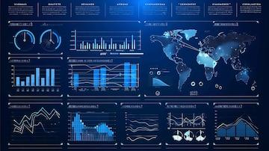
HACKATHON 2026
Theme II
Location Intelligence
Startup Spot
GLOBAL
Decoding the Geography of Everything
for the Next Generation of Entrepreneurs
Data-Driven Location Intelligence
Predictive Analytics
Team Members
Alex Stevanovic
Richard Zhang
Kevin Phan
Johnathan Li
April 2026

Slide 2
PROBLEM STATEMENT
The Commercial Feasibility Crisis
Why location intelligence matters for entrepreneurs
Every Decision is a Location Decision
Current Challenges
Where a business opens determines 70% of its success potential . Yet entrepreneurs rely on gut feeling rather than data-driven insights.
01
Gut Feeling vs. Data
Small business owners rely on intuition rather than objective location analytics
The Data Gap
Enterprise companies pay millions for location intelligence . Small businesses are left in the dark, making critical decisions blind.
02
Information Overload
Raw mapping data exists but lacks translation into actionable commercial advice
The Critical Need
03
High Failure Rates
42% of startups fail due to no market need, often tied to poor location choice
How can we ensure a new business opens in a location primed for success, rather than immediate failure?
Business Failure Due to Location
42%
of startups
fail because of poor market positioning and location decisions
Source: CB Insights Startup Failure Report

Slide 3
OUR SOLUTION
Meet Startup Spot Global
Transforming location data into entrepreneurial success
What is Startup Spot Global?
Key Innovation
An intuitive location intelligence product that shifts from simple mapping to predictive synergy. Instead of just showing users where things are, we process data to tell them where they should be.
Predictive, Not Descriptive
We don't just show where businesses exist - we predict where they should exist for maximum success
Multi-Factor Scoring
150M+
3-Score
1
Our algorithm balances density, competition, and synergy to find the sweet spot
Location Data Points Across 200+ Countries
Algorithm System
Optimal Location
Non-Technical Friendly
How It Works
Complex data science made accessible to everyday entrepreneurs without technical expertise
1
Input Business Type
User selects their planned business category (e.g., Coffee Shop, Restaurant)
2
Analyze Dataset
Platform processes 100M+ real-world coordinates and business categories
"We use data to work with the environment we are given not against it."
3
Get Recommendation
Receive definitive, data-backed location with highest success potential
- Startup Spot Global Team

Slide 4
TECHNICAL EXECUTION
Under the Hood: The Scoring Algorithm
Data strategy & technical implementation
SCORE 1
SCORE 2
SCORE 3
Hub Density
Competitor Penalty
Synergy Bonus
Base Score
Negative Score
Positive Score
Maps coordinates to define Points of Interest (POIs) Greater density = larger POI radius.
Filters by category to identify direct competitors within the POI radius.
Identifies constructive businesses nearby that drive complementary foot traffic.
Identifies active business zones
More competitors = lower score
Restaurant + Theme Park = Win
Dynamic radius based on density
Category-specific filtering
Coffee Shop + Office Building
Higher density = higher base score
Prevents oversaturated markets
Working with the market not against it
Weight
Base
Impact
Penalty
Impact
Bonus
Final Calculation
Result
Aggregate Score = Hub Density - Competitors + Synergy
Highest Score Wins

Slide 5
“With adjustable scoring weights, you can tailor the model to prioritise what matters most to your business—whether that’s avoiding competition or maximising exposure.”
CUSTOMISED IMPLEMENTATION
Do It Your Way
Personalised stratagem
Mode 3
“Location strategy isn’t one-size-fits-all.
COMPETITIVE MODE
Mode 2
Lower Competitor Penalty
Smart Mode
For dominant players confident in outperforming competitors and maximising visibility.
Mode 1
Balanced Penalty & Synergy
Opportunity Mode
For established businesses or franchises seeking a balance between competition and exposure.
Prioritises high-exposure locations
Accepts and leverages competitive environments
Higher Competitor Penalty
For small start-ups aiming to carve out a niche in uncontested or low-competition markets.
Restaurant + Theme Park = Win
Focused on market dominance and scale
Coffee Shop + Office Building
Working with the market not against it
Prioritises gaps in the market
Strongly avoids saturated areas
Ideal for early-stage growth and differentiation
Choose the mode that best aligns with your business
strategy

Slide 6
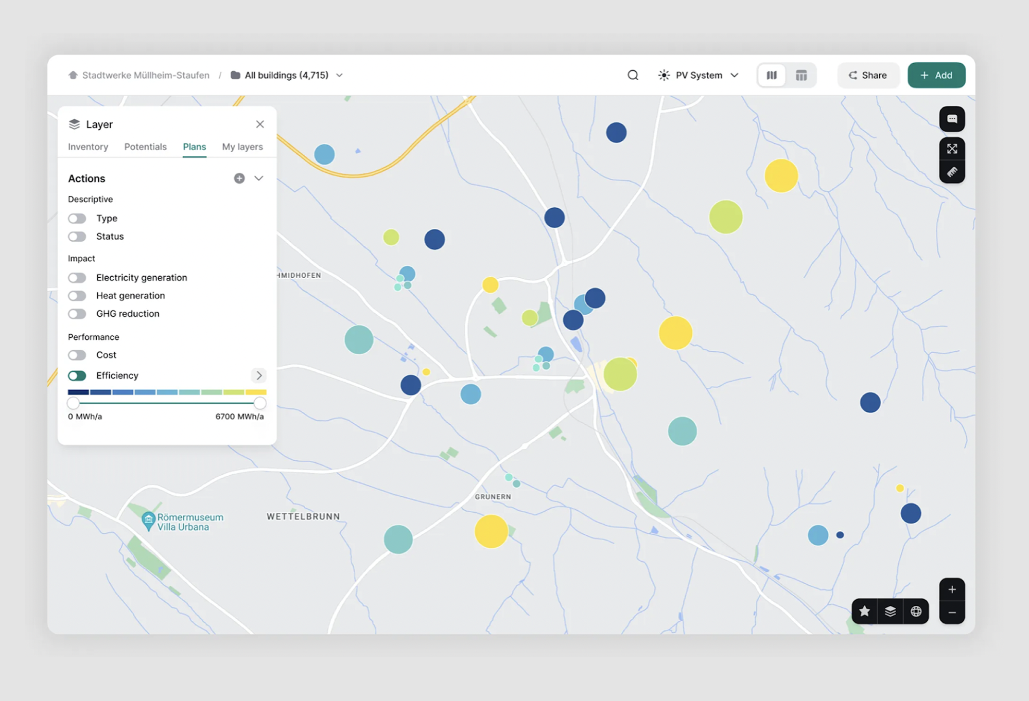
PRODUCT DESIGN
Product Demo
User experience & interface design
Live Demonstration
User Interface Preview
Watch as Startup Spot Global transforms complex data manipulation into a clean, intuitive map interface tailored for non-technical business founders.
Demo Duration: 30-60 seconds
Focus: User journey from input to recommendation
Demo Highlights
1
Frictionless Input
User selects business type with minimal clicks
2
Real-Time Processing
Backend algorithm analyzes data instantly
3
Visual Results
Clean, modern interface designed for non-technical users
Clear map visualization with scored recommendations
Target Audience
Non-technical business founders who need actionable location insights without data science expertise

Slide 7
COMMERCIAL FEASIBILITY
Market Value & Future Scope
Scalability, immediate value, and roadmap for growth
Immediate Value
Future Features & Roadmap
Startup Spot Global delivers tangible value by protecting founders from opening in dead zones or saturated markets.
V2
Confidence Scores (access to Foursquare’s premium dataset)
Integrate dataset's confidence scores to weight recommendation accuracy
V3
Demographic Integration
De-risk
Increase
Add population density, income levels, and foot traffic patterns
Investments
Success Rate
V4
Predictive Analytics
Machine learning models to predict future business trends
Global Scalability (Coming Soon)
Dataset Foundation
Market Opportunity
Built on Foursquare's global location dataset with 100M+ data points
Global SMB Market
$5.7T
Any City, Any Country
Algorithm works with coordinate and category data globally
Location Intelligence Market
$36B
Easy Deployment
Annual Growth Rate
15.2%
Minimal adaptation needed for new markets and regions
Source: MarketsandMarkets Research 2025

Slide 8
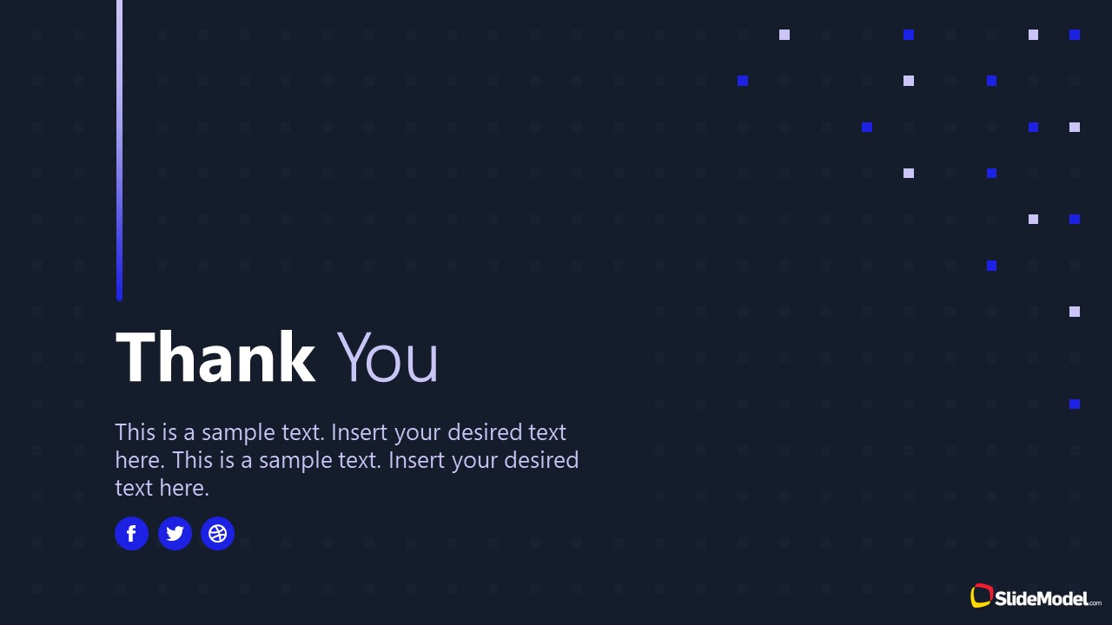
THANK YOU
Startup Spot Global
Questions & Answers
We're proud to have built a tool that turns raw data into real-world business success.
Our mission is to democratize location intelligence and empower the next generation of entrepreneurs with data-driven decisions.
Location Intelligence
Predictive Analytics
Global Scalability
Data-driven decisions for entrepreneurs
Where you should be, not just where things are
Built for any city, any country
GitHub Repository
Contact Us
github.com/startupspotau
team@startupspot.au
Built with passion for the hackathon community

